Slide 1
Approximating solutions to the heat and wave equations in two and three dimensions

Slide 2
Introduction
In this topic, we will
Discuss the heat and wave equation in two and three dimensions
Look at how we would proceed with such simulations
Focus on examples of finite-difference approximations of problems in heat conduction and wave propagation
Not look at implementations—this is left to the viewer

Slide 3
The heat and wave equations
We have approximated solutions to:
The heat and wave equations in one dimension
General boundary-value problems and Laplace’s equation one, two and three dimensions
We will now look at approximating solutions to the heat and wave equations in two and three dimensions

Slide 4
In two dimensions
The heat and wave equations are
For two dimensions, we will approximate u(x_{i}, y_{j}, t_{ℓ}) with u_{i,j;ℓ}

Slide 5
In two dimensions
First, we have a region over which heat is conducting or waves are propagating
Examples:
Heat conducting through a circuit board
Waves moving on water

Slide 6
In two dimensions
Here is a circuit board
The edges can be considered insulated

Slide 7
In two dimensions
Here is a circuit board
The edges can be considered insulated

Slide 8
In two dimensions
Here is a pool
The pool borders can be considered to be insulated

Slide 9
In two dimensions
Here is a pool
The pool borders can be considered to be insulated

Slide 10
In two dimensions
If we know the temperature, voltage or wave amplitude at each point of the domain at time t₀, we will then use our finite-difference approximation of the corresponding equation to estimate the temperature, voltage or wave amplitude one time step into the future

Slide 11
In two dimensions
Visualizing this:

Slide 12
In two dimensions
For insulated values, we assume u_{i,j;ℓ} equals the insulated value, and thus we eliminate that term

Slide 13
In two dimensions
Visualizing this:

Slide 14
In three dimensions
The heat and wave equations are
For three dimensions, we will approximate u(x_{i}, y_{j}, z_{k}, t_{ℓ}) with u_{i,j,k;ℓ}

Slide 15
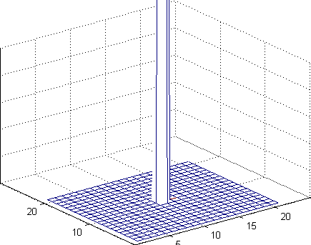
Example: heat equation in two dimensions
Here we have a sheet of metal with the center heated to 1°C while the borders are maintained at 0°C
Over time, the heat distributes throughout the region and is absorbed in the boundaries

Slide 16
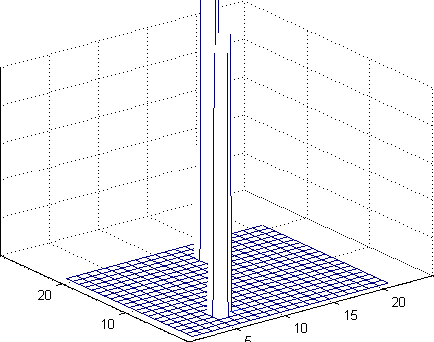
Example: heat equation in two dimensions
Here we have a sheet of metal with two points heated to 5°C and 1°C while the borders are insulated
Over time, the heat distributes throughout the region the entire region approaches the average temperature

Slide 17
Example: heat equation in two dimensions
Recall we required that

Slide 18
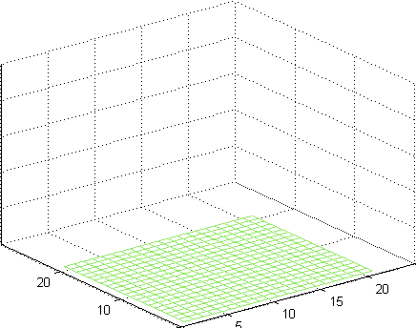
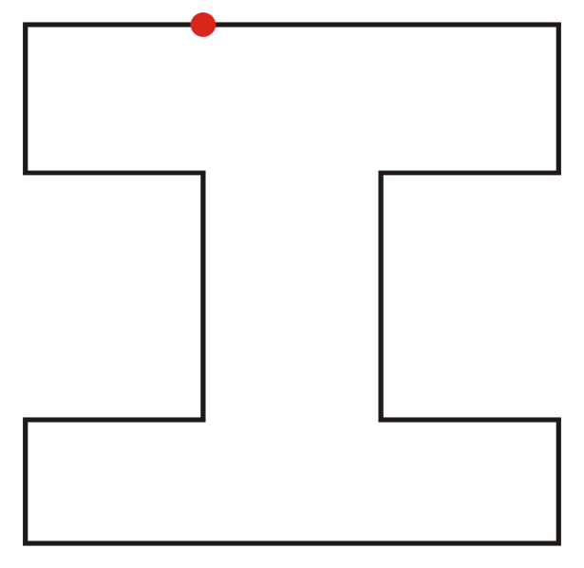
Example: heat equation in two dimensions
Here is another example of such a problem:
Suppose we have an “H” shaped room with a heater
All other walls are insulated

Slide 19
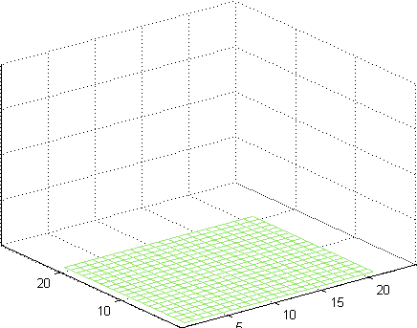
Example: heat equation in two dimensions
Here we have an insulated room with one heat source at 20ºC and one heat sink at 0ºC
The walls are insulated and the temperature is initially 0ºC

Slide 20
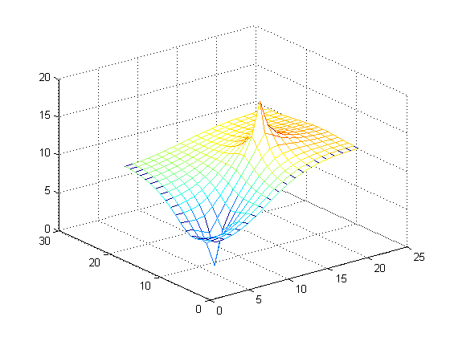
Example: heat equation in two dimensions
The heat distribution converges to the solution to Laplace’s equation shown here

Slide 21
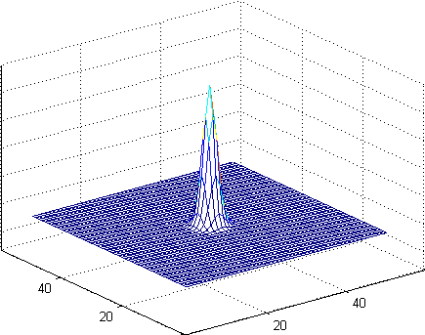
Example: wave equation in two dimensions
Here we simulate a drop of water just coming into contact with the surface
The wave spreads out and strikes an insulated boundary

Slide 22
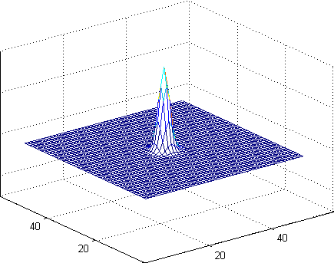
Example: wave equation in two dimensions
Now the boundaries are circular but still insulated
The wave spreads out and strikes an insulated boundary simultaneously and bounce back

Slide 23
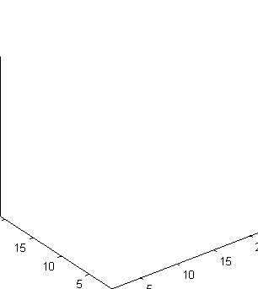
Example: heat equation in three dimensions
Here we have a single point of heat, a line of heat and a wall of heat with all other walls insulated

Slide 24
Example: wave equation in three dimensions
Here is a spherical resonance chamber
A sinusoidal voltage is applied to the exterior
It is magnified at the center
10

Slide 25
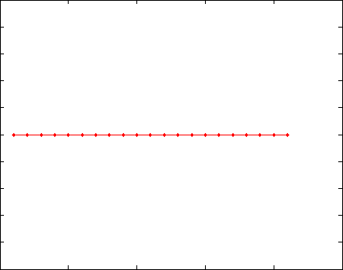
Example: wave equation in three dimensions
You can observe this phenomenon in one dimension with the code we previously wrote
sin(0.76 t)
sin(0.64 t)
10

Slide 26
Summary
Following this topic, you now
Are aware that the heat and wave equations can be simulated in two and three dimensions
Understand that we start with an initial state at time t₀ and estimate the state one time step into the future
Have seen numerous examples

Slide 27
References
[1] https://en.wikipedia.org/wiki/Heat_equation
[2] https://en.wikipedia.org/wiki/Wave_equation

Slide 28
Acknowledgments
None so far.

Slide 29
Colophon
These slides were prepared using the Cambria typeface. Mathematical equations use Times New Roman, and source code is presented using Consolas. Mathematical equations are prepared in MathType by Design Science, Inc.
Examples may be formulated and checked using Maple by Maplesoft, Inc.
The photographs of flowers and a monarch butter appearing on the title slide and accenting the top of each other slide were taken at the Royal Botanical Gardens in October of 2017 by Douglas Wilhelm Harder. Please see
https://www.rbg.ca/
for more information.

Slide 30
Disclaimer
These slides are provided for the ece 204 Numerical methods course taught at the University of Waterloo. The material in it reflects the author’s best judgment in light of the information available to them at the time of preparation. Any reliance on these course slides by any party for any other purpose are the responsibility of such parties. The authors accept no responsibility for damages, if any, suffered by any party as a result of decisions made or actions based on these course slides for any other purpose than that for which it was intended.

